Slide 1
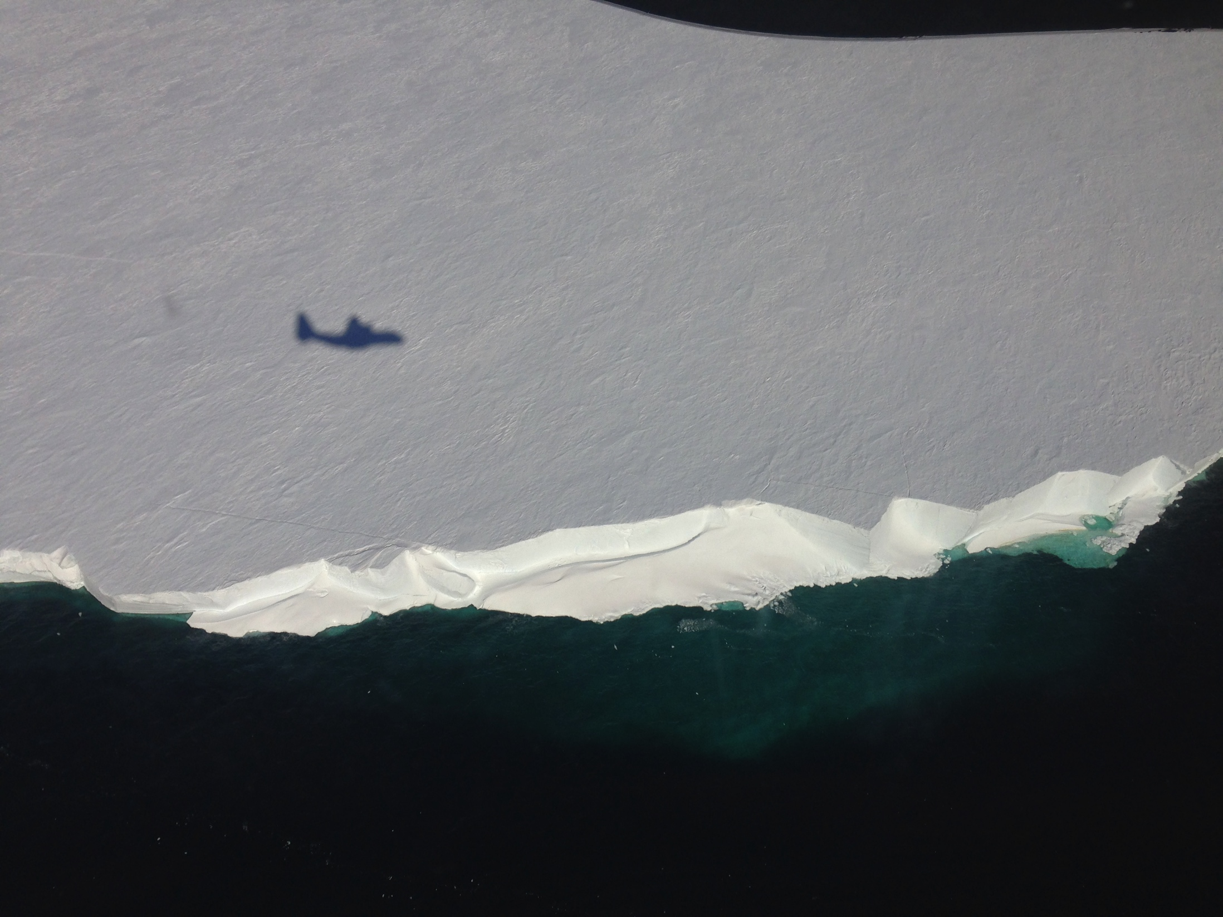

The Ross Ice Shelf
Supplementary image files for Ice Shelves Activity #3

Slide 2
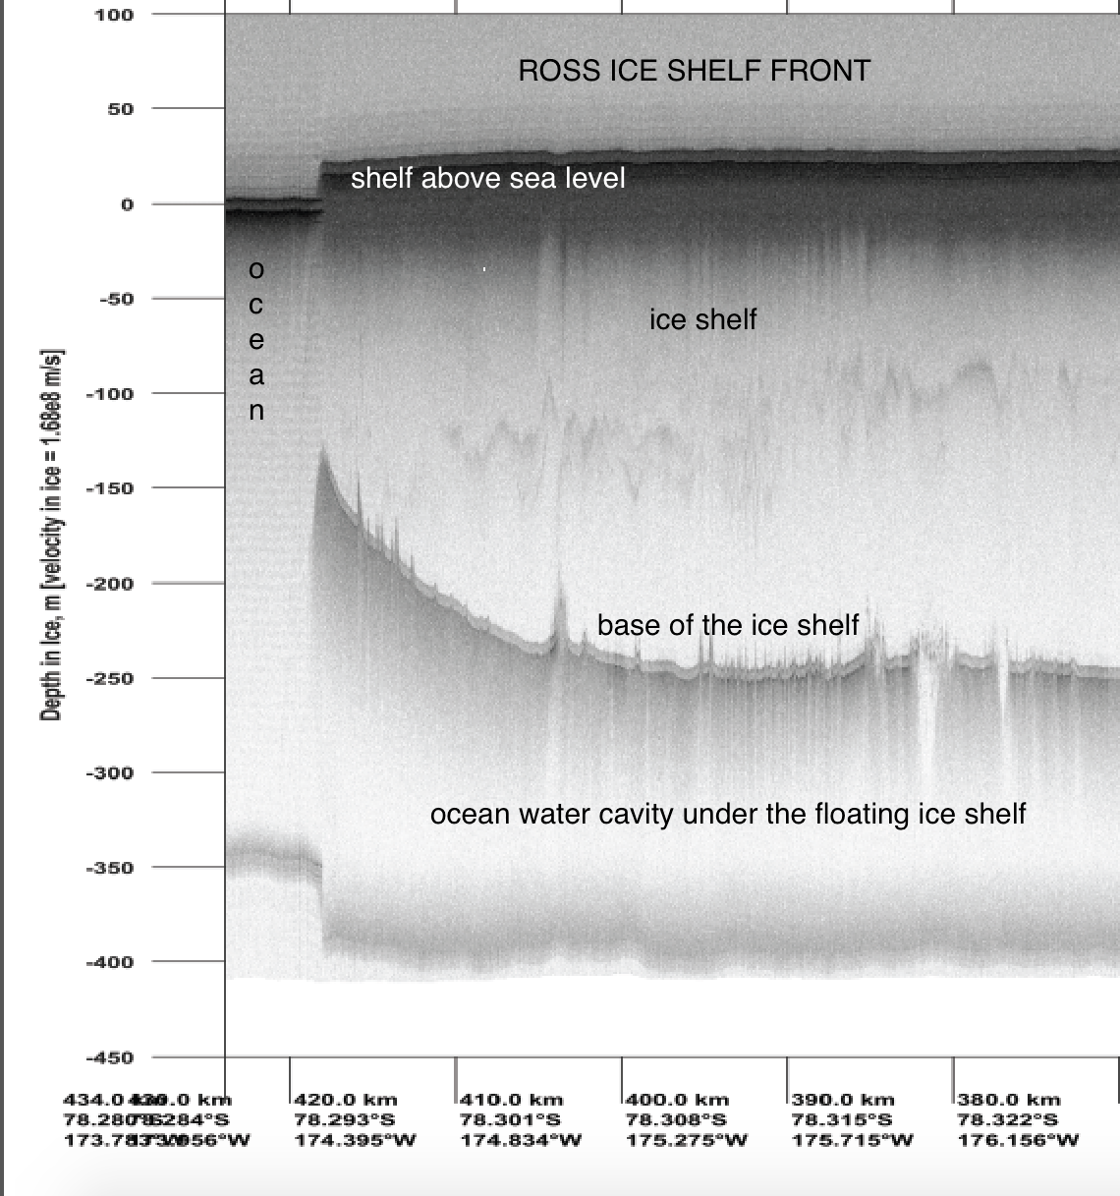
Ross Ice Shelf Front

Slide 3
The next series of slides should be printed and provided as individual sheets to groups of ~4 students so they can complete the activity for tracking the Mulock Glacier. The glacier input looks like a grey snowcone top and is outlined in the first slide. Students are measuring the thickness of the Mulock ice packet as it moves through time & distance. Mulock ice travels ~1.25 kms a decade. Students will calculate the time the ice has been on the shelf for each image, and how long it remains intact.
Tracking Ice Along the Shelf

Slide 4
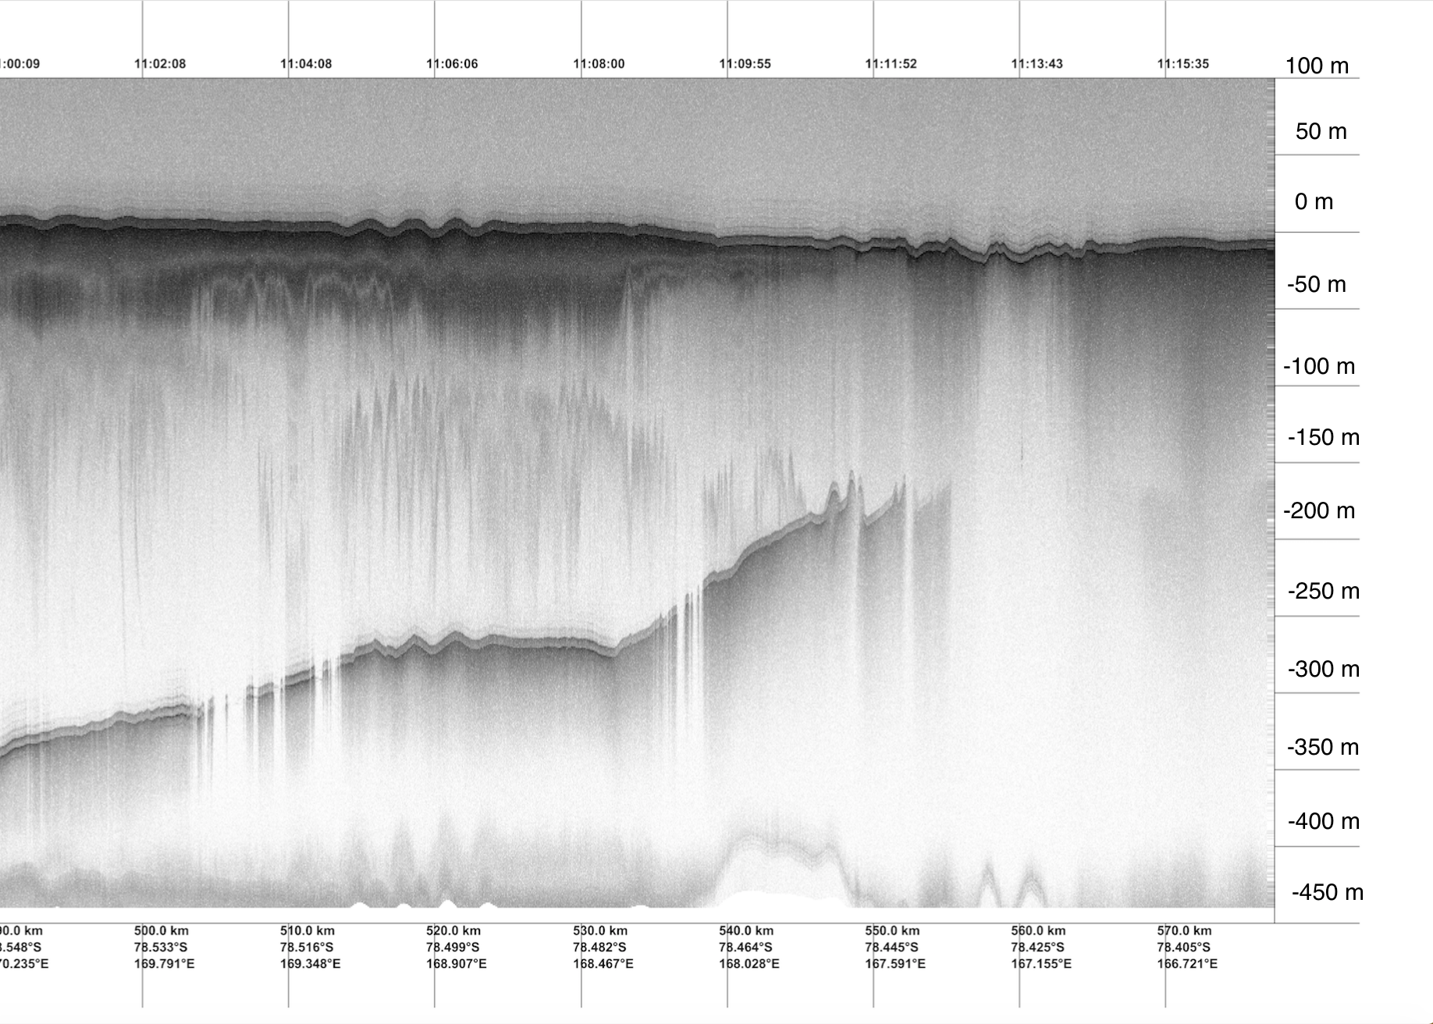
#1 - Line at km 790 closest to where Mulock Glacier feeds onto the ice shelf
Mulock ice

Slide 5
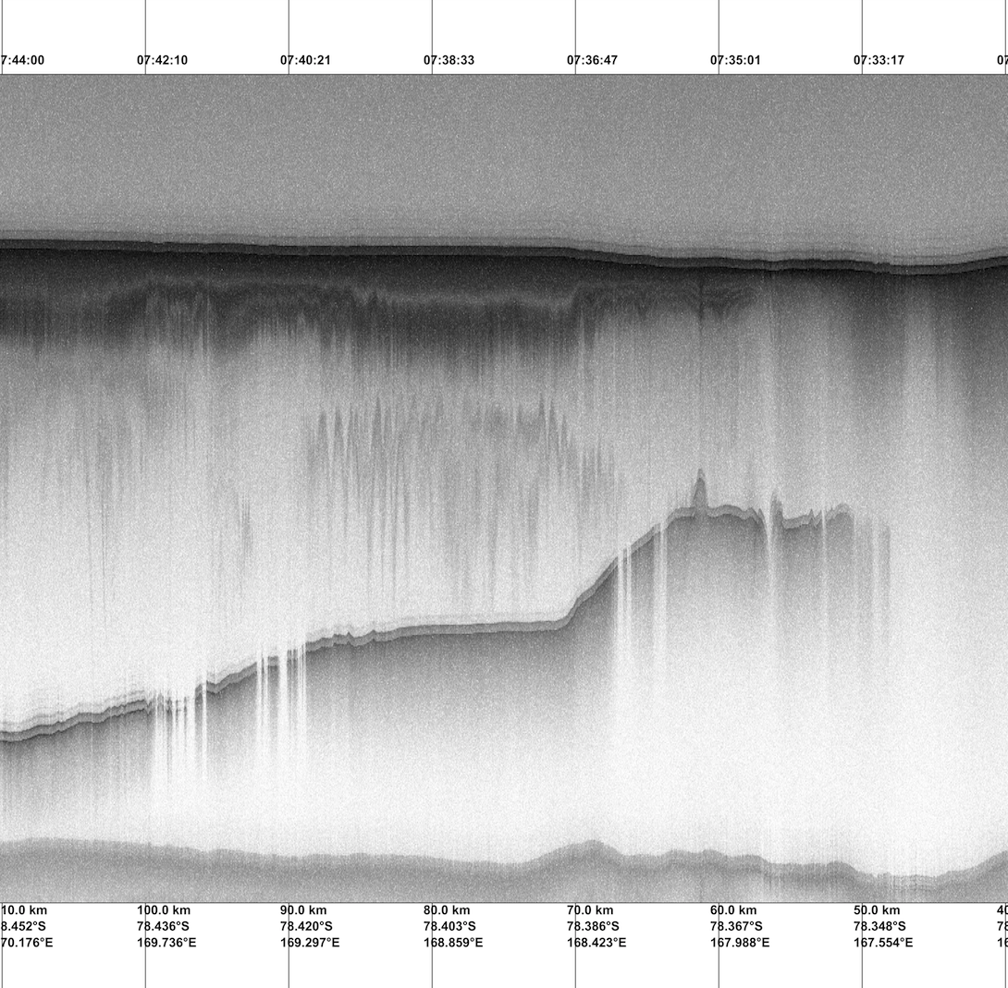

#2 - Line at km 800 Mulock Glacier moving forward on the ice shelf
Mulock ice

Slide 6

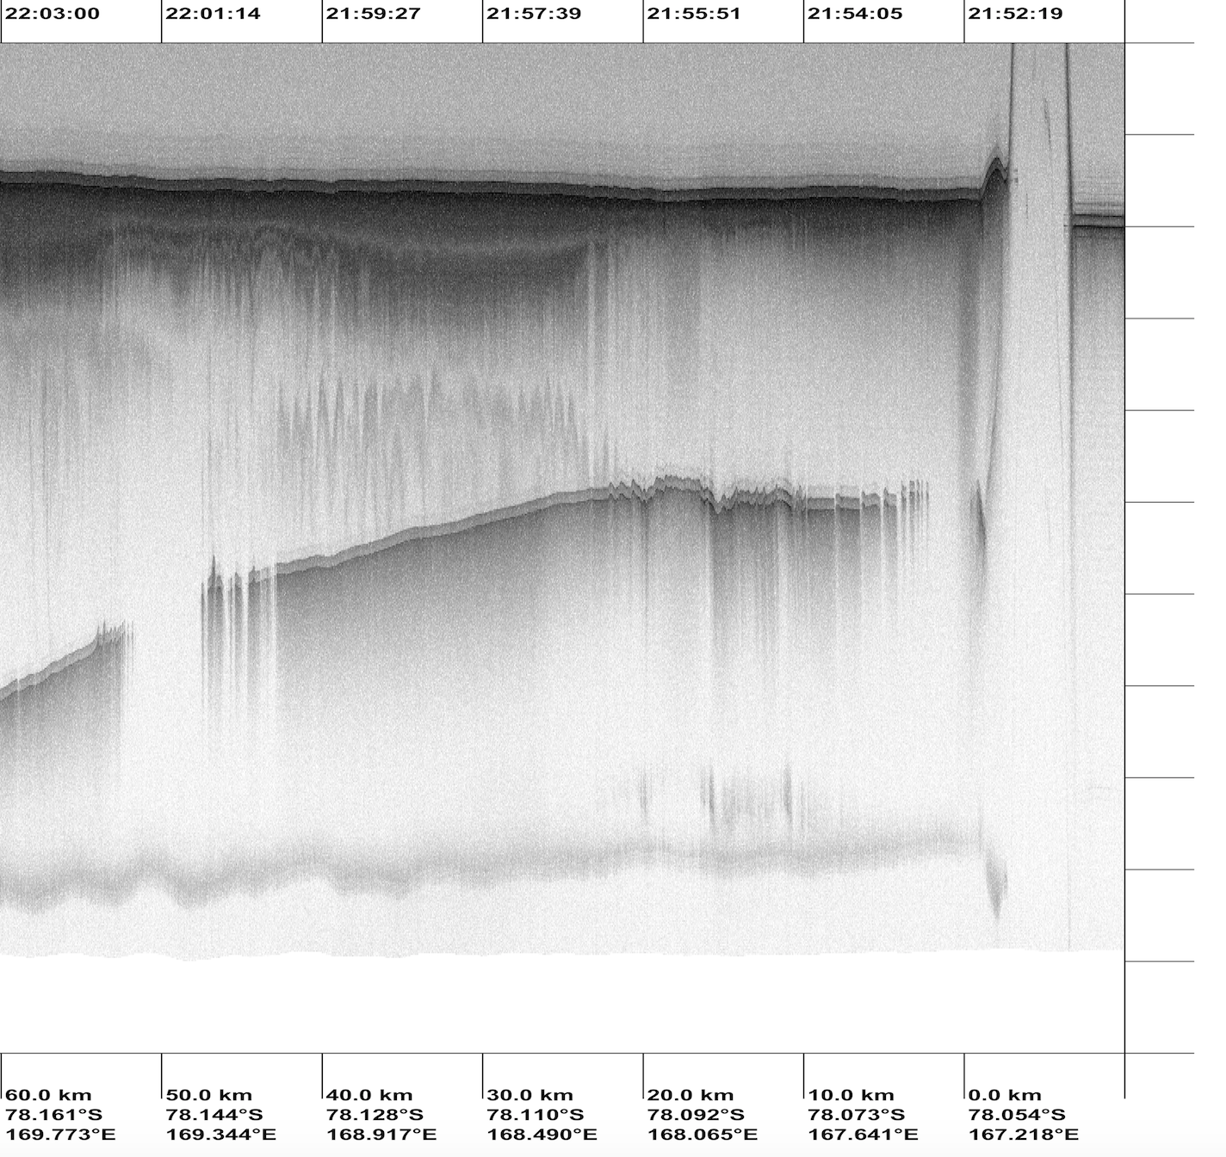
#3 - Line at km 830 Mulock Glacier moving forward on the ice shelf
Mulock ice
Mulock ice

Slide 7
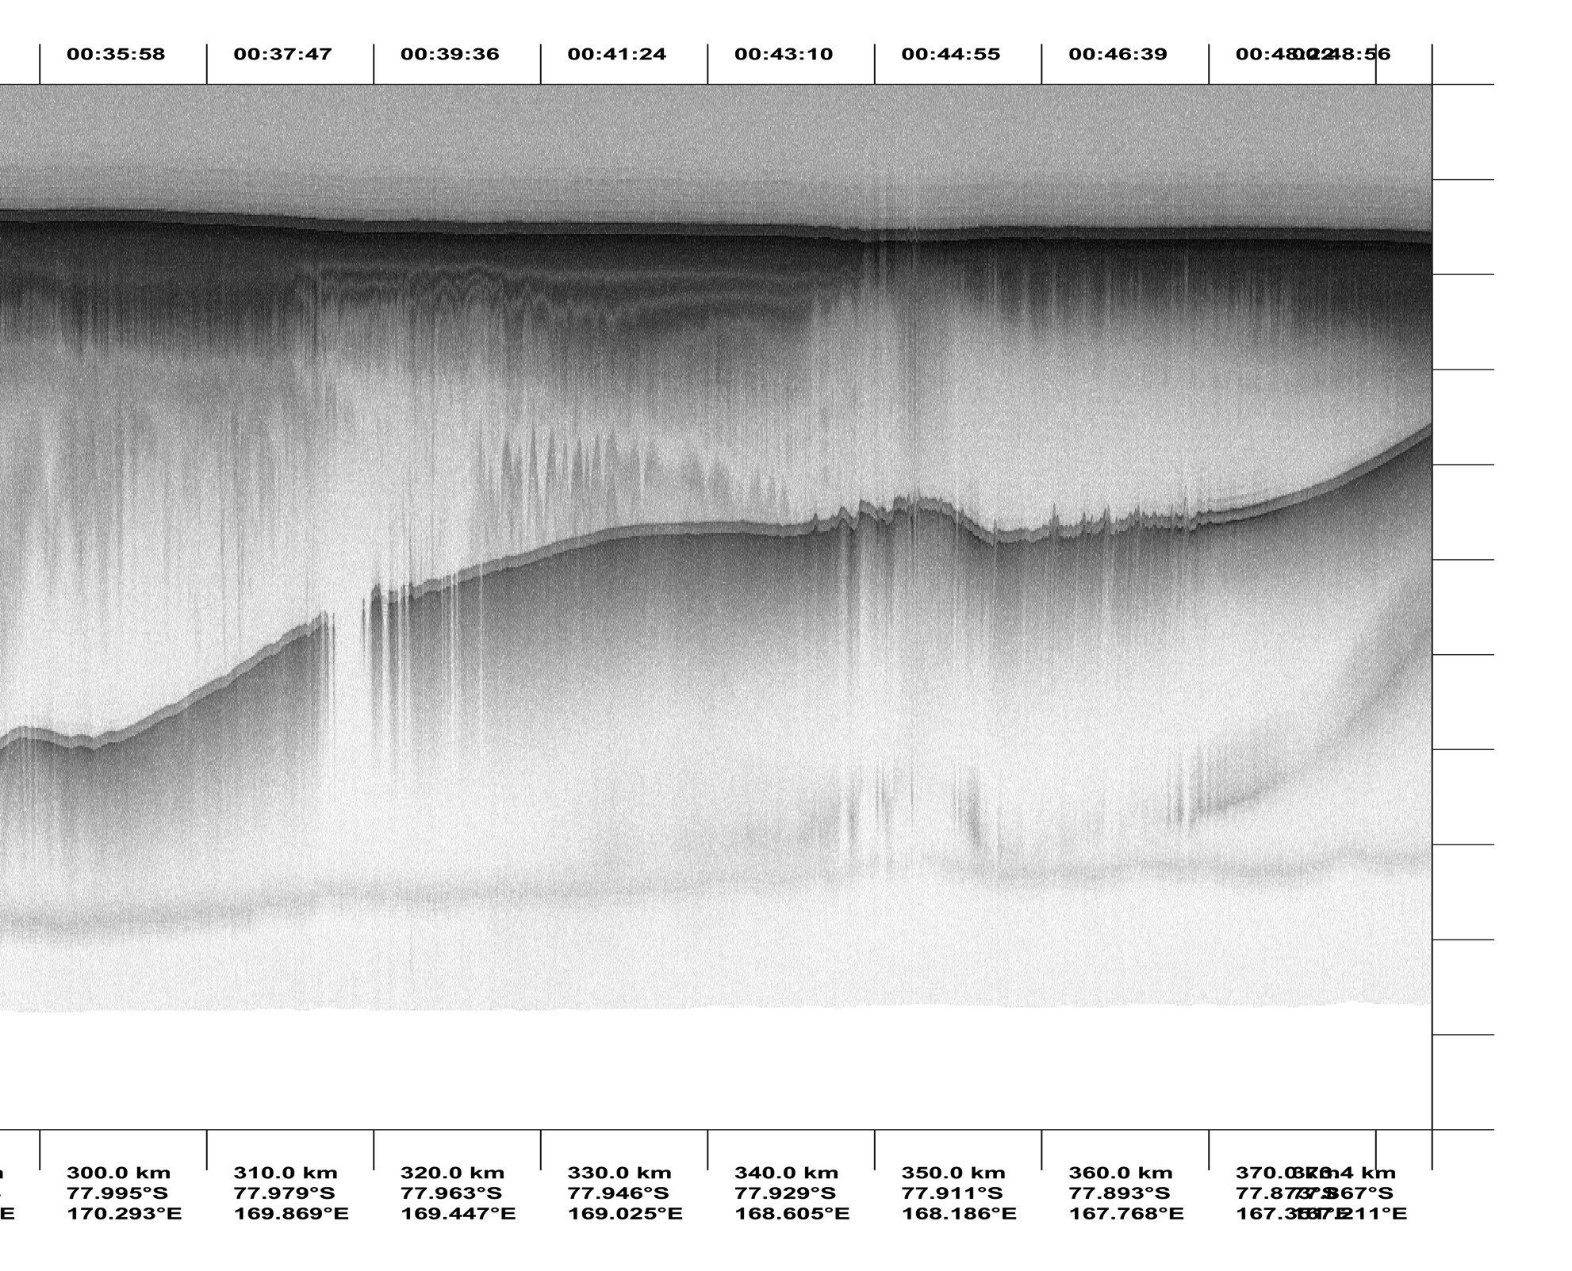
#4 - Line at km 850 Mulock Glacier moving forward on the ice shelf
Mulock ice

Slide 8
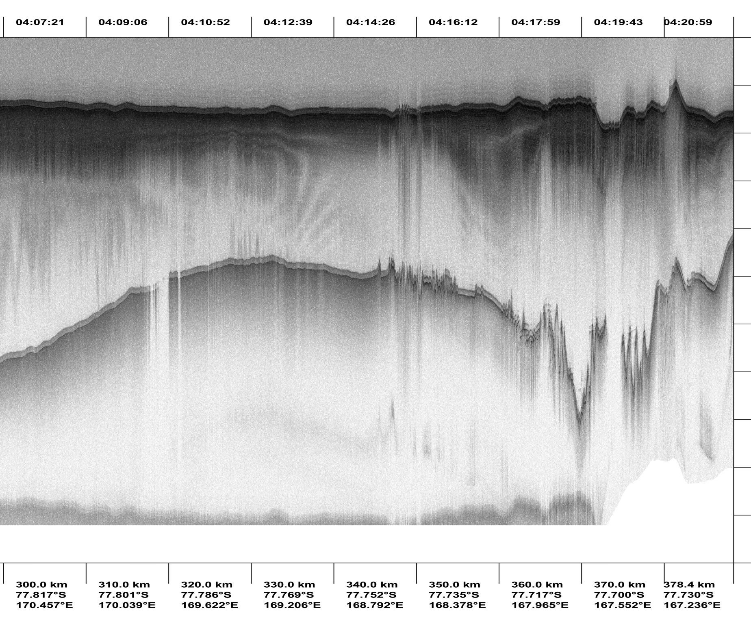
#5 - Line at km 870 Mulock Glacier moving forward on the ice shelf
Mulock ice

Slide 9
Models for the final discussion
Models by DeConto and Pollard based on IPCC report categories 2.6 and 8.5 focused on the stability of the ice sheet and ice shelves.

Slide 10
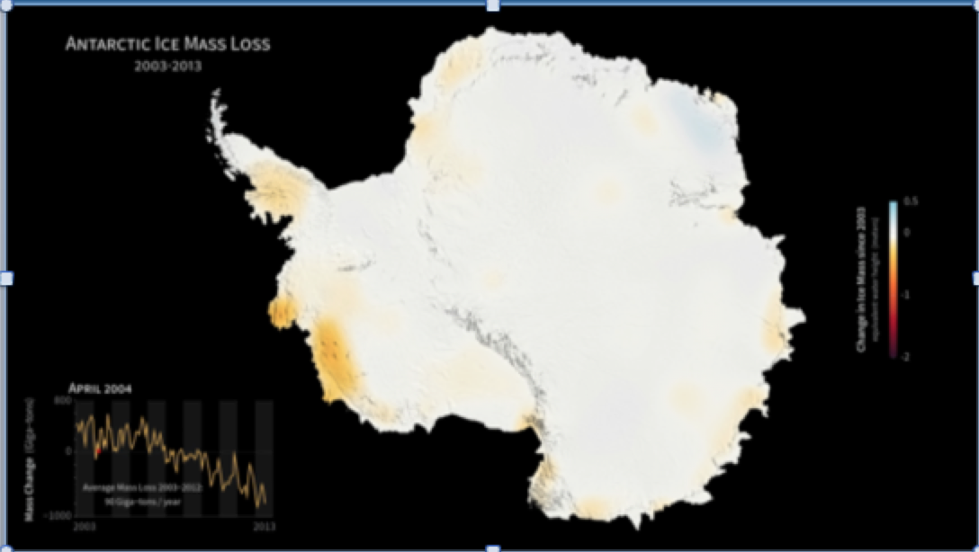
Evidence #4: Losing Ice Mass…
Ice Loss in Antarctica 2003 to 2013 – West Antarctica and over to the Ross Ice Shelf.(NASA GRACE satellite data)
https://www.youtube.com/watch?v=3jbMCyE3eUU
Notes:
MOVIE – I removed this and provided the link to reduce the file size.

Slide 11
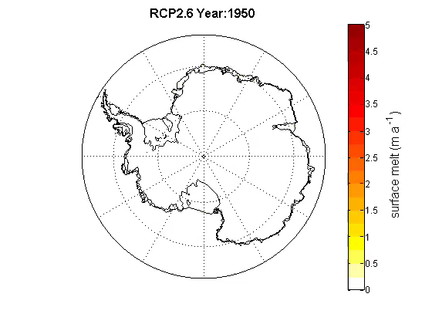
Model by DeConto and Pollard based on the International Panel on Climate Change (IPCC) scenario RCP 2.6 which presumes the global annual GHG emissions peak by 2020 and decline substantially after that.

Slide 12

Model by DeConto and Pollard based on the International Panel on Climate Change (IPCC) scenario RCP 8.5 which presumes the global annual GHG emissions continue to rise throughout the century.

